Slide 1
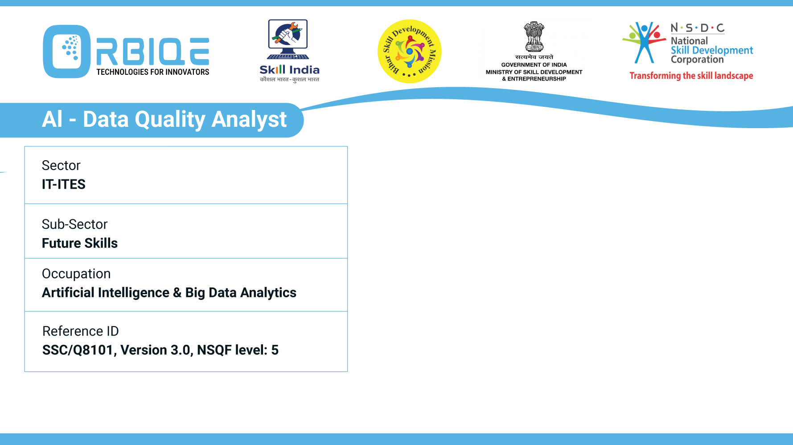
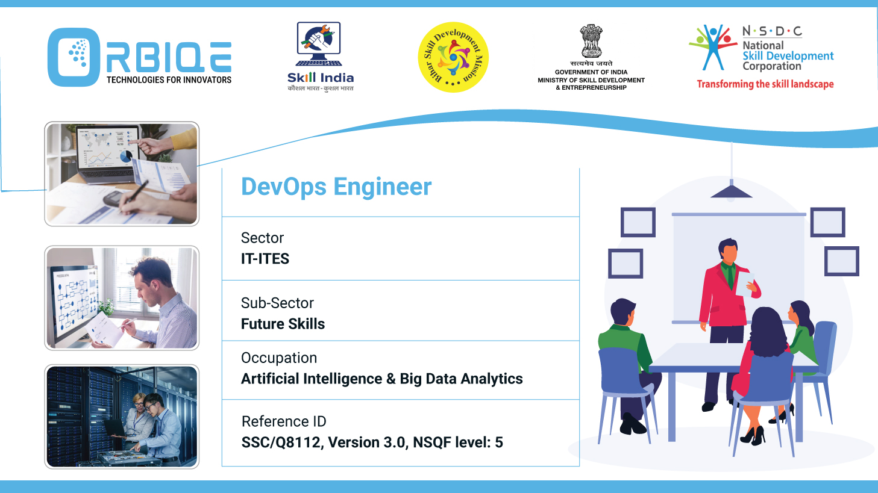
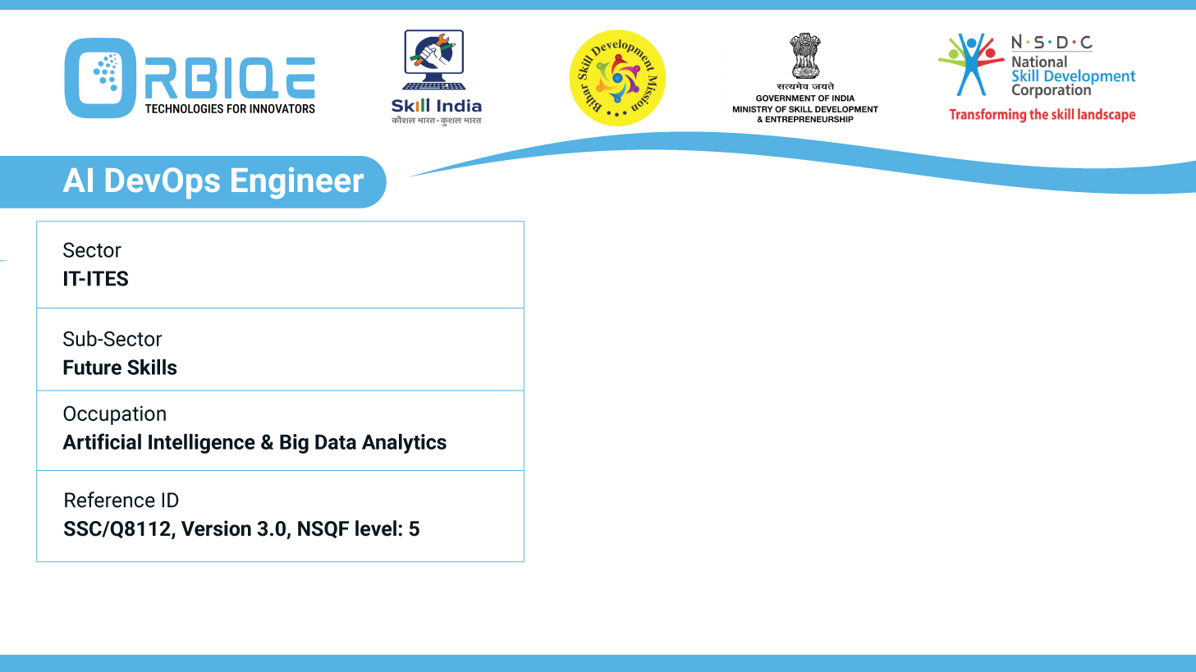
Name- Krishna Kant Dubey

Slide 2

Careers in AI & Big Data Analytics

Slide 3
Agenda
Career map for roles in AI & Big Data Analytics
Differences Supervised Learning, Unsupervised Learning and Deep Learning“

Slide 4
Career map for roles in AI & Big Data Analytics
Data Analyst
Responsibilities: Collects, processes, and analyzes large datasets to reveal trends, patterns, and actionable insights. Prepares reports for stakeholders and builds dashboards to visualize findings.
Typical Tools: Excel, SQL, Tableau, Power BI, Python.

Slide 5
Career roles
Data Analyst
Responsibilities: Collects, processes, and analyzes large datasets to reveal trends, patterns, and actionable insights. Prepares reports for stakeholders and builds dashboards to visualize findings.
Typical Tools: Excel, SQL, Tableau, Power BI, Python.

Slide 6
Career map for roles in AI & Big Data Analytics
Data Scientist (Advanced/Progression Role)
Responsibilities: Leverages advanced analytics, machine learning, and predictive models to solve complex business problems. Designs experiments, automates workflows, and develops custom data products.
Career Path: Many experienced analysts grow into this role with upskilling.

Slide 7
Analyse the differences between key terms such as Supervised Learning, Unsupervised Learning and Deep Learning
Supervised Learning
Unsupervised Learning
Deep Learning

Slide 8
Supervised Learning

Slide 9
Unsupervised Learning

Slide 10
Deep Learning

Slide 11
Thank You

